Slide 1

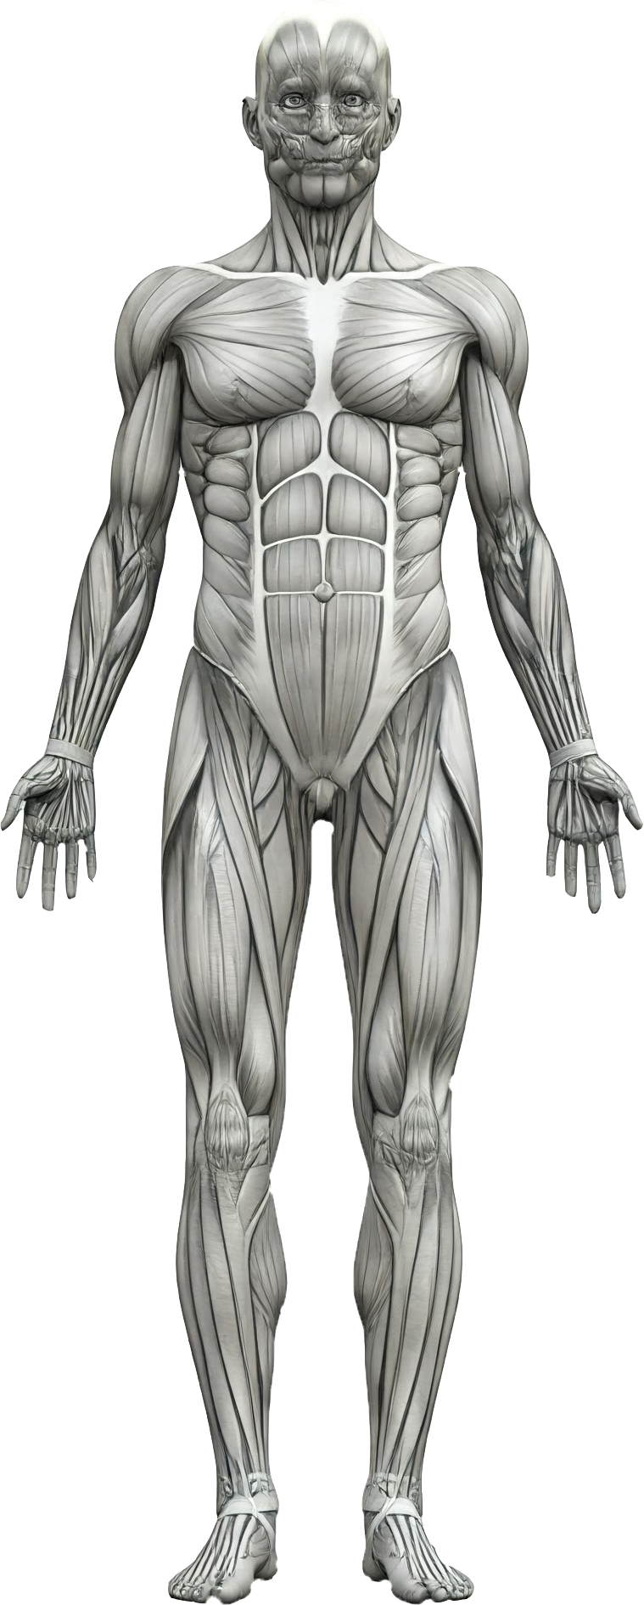
Human Twin
Run Prediction
Diabetes Prediction
Inputs …………
Heart Attack Prediction
Inputs …………
Cholesterol Prediction
Inputs …………
Brain Tumor Prediction
Inputs …………
Alzheimer Prediction
Inputs …………
Skin Cancer Prediction
Inputs …………
Lung X-Ray Prediction
Inputs …………

Slide 2

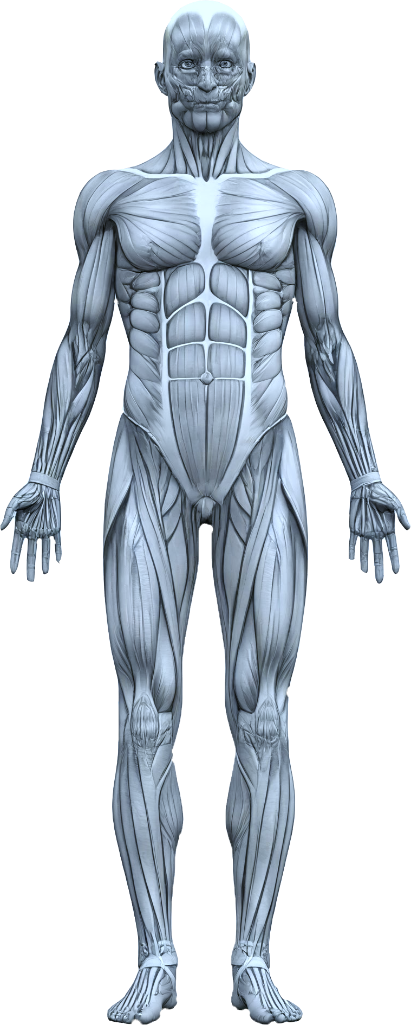
Human Twin
Analyzing Results ……

Slide 3
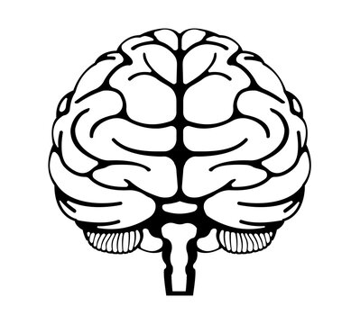

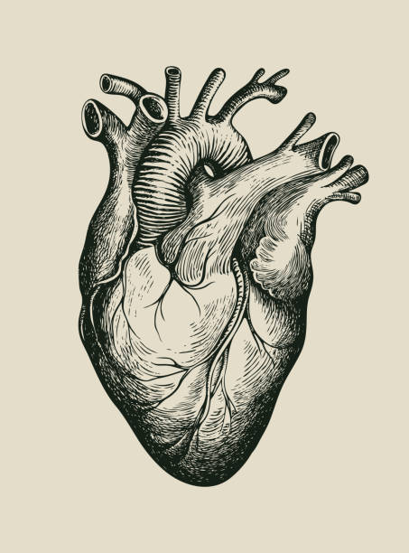
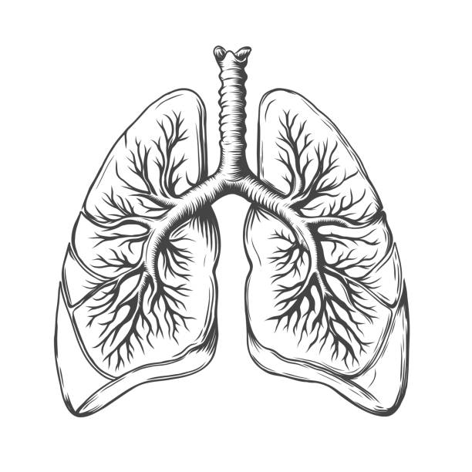
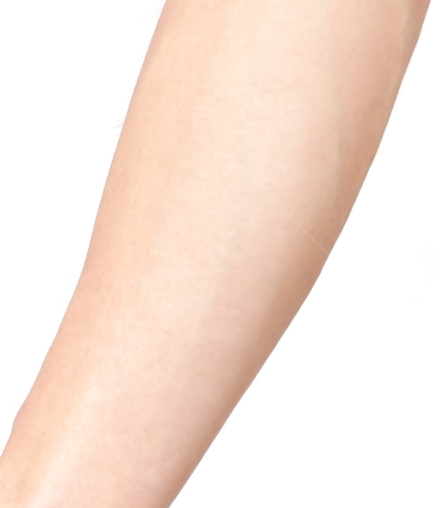
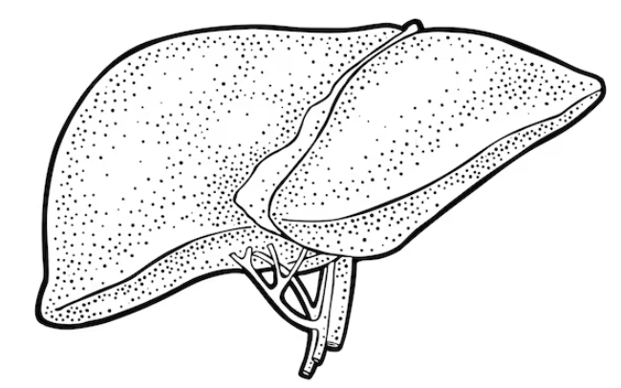
Human Twin
Brain Tumor Prediction
Alzheimer Prediction
Heart Attack Prediction
Skin Cancer Prediction
Cholesterol Prediction
Key Symptoms
Lifestyle suggestions
Lung X-Ray Prediction
Diabetes Prediction

Slide 4
Human Twin

